Slide 1
WINTER CONSULTING Consulting and Analytical Club IIT Guhawati:
DINESH JANGIR
232694
dineshjangir27712@gmail.com

Slide 2
Problem Statement: The Future of the Internet/ The AI War (Strategy / Growth)
Background:
Google was the undisputed leader in the search engine market, maintaining a dominant position for over a decade. For many people, it was the way to access the internet. But on 22nd Nov 2022 after the launch of the ChatGPT tables turned for Google. AI changed the way, how people use get information.
Meanwhile, Microsoft was struggling in the huge search engine market. But its investment in the OpenAI changed the game. By integrating, AI products like Copilot, Bing AI chat, etc, directing into its products like Edge and Windows. This has been a huge issue for Google as around 60 percent of its revenue comes from search Ads.
Additionally, Google‘s AI chatbot, Bard failed to get the customer’s attention. And the launch of ChatGPT 4 turbo, which can interpret images, sound, etc. Will google lose the AI War or the Launch of Gemini is giving Google a second chance?
Client Goal:
You’ve been approached to strategies to help google on to improve Bard. And at the same time, how to integrate AI into its products and services to increase its revenue stream.

Slide 3
Additionally, make sure to answer the following questions.
Questions:
Analyse Microsoft's integration of AI in its products and services. And how it is a threat to Google’s business.
Analyse Google’s current position as a Search engine after the launch of ChatGPT.
What challenges Google is likely to face being a late mover in the AI war? Suggest strategies to overcome them.
What advantages does Google have against OpenAI in creating a better AI bot user experience? If there are any.
Provide a clear idea of the company's primary target audience, its features, and its mode of functionality.
How can Google strategically integrate AI to create new monetisable services and products within its ecosystem?

Slide 4
ChatGpt:
ChatGPT is a chatbot developed by OpenAI that was launched on November 30, 2022. It is based on a large language model that can generate human-like text and perform tasks based on written commands. It can also create creative content such as poems, stories, code, and more. ChatGPT can understand and communicate fluently in different languages, and it can format its responses using markdown, code blocks, and LaTeX. ChatGPT aims to provide helpful, positive, polite, empathetic, interesting, entertaining, and engaging conversations to the users.
ChatGPT is the latest version of the GPT series of models, which started with GPT in 2018, followed by GPT-2 in 2019, and GPT-3 in 2020. The GPT models are based on the transformer architecture, which uses attention mechanisms to process and generate natural language. The GPT models are trained on a huge amount of text data from the internet, and they can learn from any domain and task.
ChatGPT became one of the fastest-growing consumer software applications in history, gaining over 100 million users in just two months. It also contributed to the growth of OpenAI’s valuation to $29 billion. ChatGPT has been used for various purposes, such as education, entertainment, research, and business

Slide 5
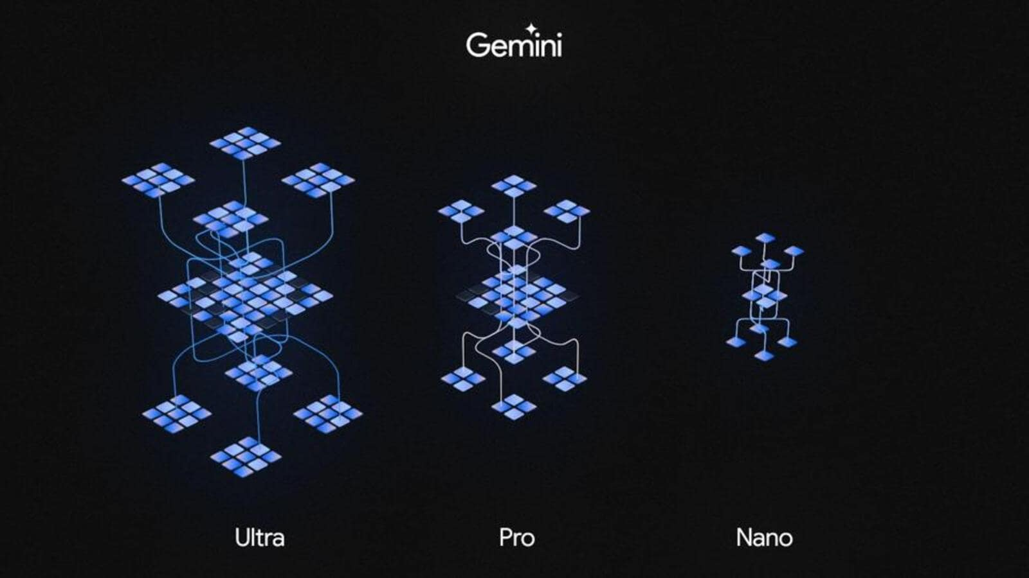
Google Gemini:
Google launched Gemini, its most advanced AI model, on December 6, 2023. This large language model (LLM) was unveiled by CEO Sundar Pichai at the I/O developer conference in June. Gemini is designed to be multimodal and was released in phases, with the first phase available to developers from December 13, 2023, through Google Cloud's API. It offers various modes such as Ultra, Pro, and Nano. The model aims to outperform existing AI models, demonstrating its capabilities in language-related tasks. Gemini represents a significant leap in artificial intelligence, showcasing Google's commitment to advancing AI technology

Slide 6
Analyse Microsoft's integration of AI in its products and services. And how it is a
threat to Google’s business.
Microsoft's strategic integration of AI, particularly through its collaboration with OpenAI, poses a significant threat to Google. By seamlessly incorporating AI products such as Copilot and Bing AI chat into flagship products like Edge and Windows, Microsoft gains a competitive edge. This becomes a critical challenge for Google, given that approximately 60% of its revenue relies on search Ads, a sector directly impacted by Microsoft's AI advancements.
Moreover, the incorporation of Microsoft's ChatGPT into the Bing search engine introduces a potential shift in user behavior, leading to users bypassing traditional search engines like Google. This integration not only challenges Google's search engine dominance but also raises concerns for Alphabet, Google's parent company.
In summary, Microsoft's AI integrations, including ChatGPT, not only threaten Google's search Ads revenue but also pose a broader challenge to its overall market share and user engagement.

Slide 7
Analyse Google’s current position as a Search engine after the launch of ChatGPT.
Google's position as a search engine has encountered changes post the introduction of ChatGPT. Here are some points to consider:
User Experience Enhancement: ChatGPT provides a more conversational and user-friendly search experience compared to traditional keyword-based searches. Its natural language processing capabilities enable users to obtain specific information seamlessly.
Challenges to Keyword-Centric Model: Google's traditional model relies heavily on keywords for search queries. ChatGPT's success challenges this model by offering a more dynamic and context-aware approach, potentially prompting Google to reconsider its search algorithm.
Market Share Dynamics: While Google currently maintains a substantial 93% global market share, the convenience and efficiency offered by ChatGPT may attract a portion of users. Google's continued dominance depends on its ability to address evolving user preferences.
Competition in AI Integration: The integration of AI technologies like ChatGPT into various platforms, including Bing, intensifies the competition. Google may face challenges in retaining user engagement if competitors offer more advanced and user-friendly AI-driven search experiences.

Slide 8
What challenges Google is likely to face being a late mover in the AI war? Suggest strategies to overcome them.
Google is likely to face several challenges being a late mover in the AI war, as it competes with other tech giants that have already established their presence and dominance in the field. One of the biggest challenges is catching up with Microsoft’s integration of AI in its products and services, such as Windows, Office, Azure, Bing, Cortana, and LinkedIn. Microsoft has been investing heavily in AI research and development, acquiring AI startups, partnering with AI companies, and launching AI initiatives and platforms. Microsoft has also been applying AI to various domains and sectors, such as education, healthcare, gaming, and cloud computing. Google needs to match or surpass Microsoft’s efforts and innovations in AI and offer more value and benefits to its customers and partners.
Another challenge that Google may face is the lack of data privacy regulations, which could lead to a loss of consumer trust and confidence. Data is the fuel for AI, and Google collects and analyzes a vast amount of data from its users, such as their search queries, browsing history, location, preferences, and behavior. However, data privacy is a major concern for many users, who may not be aware of or consent to how Google uses their data, or who may fear that their data may be compromised, leaked, or misused. Google needs to comply with the existing and emerging data privacy laws and regulations, such as the General Data Protection Regulation (GDPR) in the European Union, and the California Consumer Privacy Act (CCPA) in the United States.

Slide 9
What advantages does Google have against OpenAI in creating a better AI bot
user experience? If there are any.
Google has several advantages against OpenAI in creating a better AI bot user experience, which is the quality and satisfaction of the interaction between the user and the AI system. One of the advantages is that Google has a vast amount of data that it can use to train its AI models, which are the algorithms and programs that enable the AI system to perform tasks and learn from data. Data is essential for AI, as it provides the information and feedback that the AI system needs to improve its performance and accuracy. Google collects and analyzes a huge amount of data from its users, such as their search queries, browsing history, location, preferences, and behavior, through its various products and services, such as Google Search, Gmail, Google Maps, YouTube, and Google Assistant. This gives Google an edge over OpenAI, which is a research organization that aims to create and promote artificial general intelligence (AGI), which is the ability of an AI system to perform any intellectual task that a human can. OpenAI has less access and control over the data that it uses to train its AI models, as it relies on public or third-party sources, such as Wikipedia, Reddit, or GitHub.

Slide 10
Provide a clear idea of the company's primary target audience, its features, and its mode of functionality.
Google’s primary target audience is anyone who uses the internet to search for information. This means that Google is targeting a very large and diverse group of customers, who have different needs, preferences, and behaviors. Google is not limiting its audience to a specific segment, such as age, gender, location, or income. Rather, Google is aiming to serve anyone who has access to the internet and wants to find information on any topic or query.
Google’s features include a simple and intuitive user interface, fast search results, and a vast database of information. These are some of the characteristics that make Google’s product or service appealing and valuable to its customers. A simple and intuitive user interface means that Google’s website and app are easy to use and understand, and that customers can quickly and easily enter their queries and get their results. Fast search results mean that Google’s search engine can process and display the most relevant and useful information for the customers’ queries in a matter of seconds. A vast database of information means that Google’s search engine can access and analyze a huge amount of data from various sources, such as websites, books, images, videos, maps, and news, and provide customers with comprehensive and diverse information on any topic or query.

Slide 11
How can Google strategically integrate AI to create new monetisable services
and products within its ecosystem? Google can strategically integrate AI to create new monetizable services and products within its ecosystem by investing in AI research and development. This means that Google can allocate more resources and funds to conduct scientific and technological research and innovation in the field of AI, and to develop new and improved AI models, algorithms, and systems. This can help Google gain a competitive edge and a first-mover advantage in the AI market, and to create new and valuable intellectual property and patents.
Google can also leverage its vast ecosystem of products and services that work together to create value and benefits for the customers and the company. This means that Google can integrate AI with its existing products and services, such as Google Search, Google Maps, and Google Assistant, to enhance their features, functions, and benefits, such as by providing personalized recommendations, relevant results, and smart suggestions.
Google can monetize its AI products and services by charging fees, subscriptions, or commissions to the customers or the partners who use them, or by generating revenue from advertising, data, or analytics. This can help Google increase its revenue, profit, and market share, and to achieve its financial and strategic goals.

Slide 12
Thank You

